Slide 1
Distributed
Deep Learning
(part 1)
Joseph E. Gonzalez
Co-director of the RISE Lab jegonzal@cs.berkeley.edu

Slide 2
What is the Problem Being Solved?
Training models is time consuming
Convergence can be slow
Training is computationally intensive
Not all models fit in single machine or GPU memory
Less of a problem: big data
Problem for data preparation / management
Not a problem for training … why?

Slide 3
On Dataset Size and Learning
Data is a a resource! (e.g., like processors and memory)
Is having lots of processors a problem?
You don’t have to use all the data!
Though using more data can often help
More data often* dominates models and algorithms
*More data also enables more sophisticated.

Slide 4
What are the Metrics of Success?
Marketing Team: Maximize number of GPUs/CPUs used
A bad metric … why?
Machine Learning: Minimize passes through the training data
Easy to measure, but not informative … why?
Systems: minimize time to complete a pass through the training data
Easy to measure, but not informative … why?

Slide 5
Ideal Metric of Success
How do we measure Learning?
“Learning”
Second
“Learning” Record
Record
Second
=
x
Convergence
Machine Learning
Property
Throughput
System
Property

Slide 6
Training and Validation
This is the thing we want to minimize
Test* Error
Error
This is what our training algorithm tries to minimize.
Training Error
Time
*If you are making modeling decisions based on this then it should be called validation error.

Slide 7
Metrics of Success
Minimize training time to “best model”
Best model measured in terms of test error
Other Concerns?
Complexity: Does the approach introduce additional training complexity (e.g., hyper-parameters)
Stability: How consistently does the system train the model?

Slide 8
Two papers
NIPS 2012 (Same Year as AlexNet)
2018 (Unpublished on Arxiv)

Slide 9
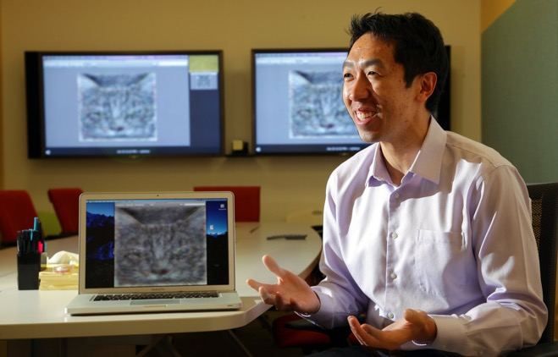
Large Scale Distributed Deep Networks
NIPS 2012 (Same Year as AlexNet)
Described the system for the 2012 ICML Paper
Discovers Cat Features
Label
DistBelief

Slide 10
Building High-Level Features Using Large Scale Unsupervised Learning
ICML 2012
Pre-Convolutional* Architecture
9x “deep”
Each Neuron has separate weights
sparse connectivity
30x bigger than other deep nets.
~1 billion parameters!
*This pre-dates AlexNet but is two decades after LeNet.

Slide 11
More Context (ML circa 2012)
Focus of existing distributed ML research
Convex Optimization (e.g., SVMs, Lasso)
Matrix Factorization
Graphical Models
Key systems at the time
Map Reduce → not great for iterative computation (why?)
Spark really wasn’t visible to ML community
GraphLab → A truly wonderful system*
we worked with Quoc/Andrew to get their model running on GraphLab but wasn’t as performant.
*Developed by the speaker.

Slide 12
Key Problems Addressed in DistBelief Paper
Main Problem
Speedup training for large models
Sub Problems
How to partition models and data
Variance in worker performance → Stragglers
Failures in workers → Fault-Tolerance

Slide 13
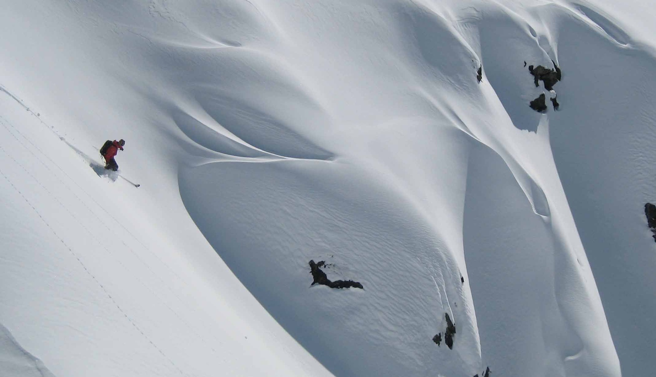
Crash Course on Stochastic Gradient Descent

Slide 14
The Gradient Descent Algorithm
initial model parameters (random, warm start)
For 𝜏 from 1 to convergence:
Evaluated
at
Learning Rate
Average Gradient of Over Training Dataset
How do we distribute this computation?

Slide 15
The Gradient Descent Algorithm
initial model parameters (random, warm start)
For 𝜏 from 1 to convergence:
Evaluated
at
Learning Rate
Average Gradient of Over Training Dataset
How do we distribute this computation?
Data parallelism: divide data across machines, compute local gradient sums and then aggregate across machines. repeat.
Issues?
Repeatedly scanning the data… what if we cache it?

Slide 16
also substantially improved the programming API over Hadoop.

Slide 17
The Gradient Descent Algorithm
initial model parameters (random, warm start)
For t from 1 to convergence:
Can we use statistics to improve this algorithm?
Evaluated
at
Learning Rate
Average Gradient of Over Training Dataset

Slide 18
The Gradient Descent Algorithm
initial model parameters (random, warm start)
For t from 1 to convergence:
Can we use statistics to improve this algorithm?
The empirical gradient
is an approximation of what I really want:
Law of large numbers → more data provides a better approximation (variance in the estimator decreases linearly)
Learning Rate
Average Gradient of Over Training Dataset
Do I really need to use all the data?

Slide 19
The Gradient Descent Algorithm
initial model parameters (random, warm start)
For t from 1 to convergence:
The empirical gradient
is an approximation of what I really want:
Law of large numbers → more data provides a better approximation (variance in the estimator decreases linearly)
Learning Rate
Random subset of the data
Small B: fast but less accurate
Large B: slower but more accurate

Slide 20
initial vector (random, zeros …)
For t from 1 to convergence:
Gradient Descent
initial vector (random, zeros …)
Assuming Decomposable Loss Functions
For t from 0 to convergence:
Stochastic Gradient Descent

Slide 21
Gradient Descent

Slide 22
Stochastic Gradient Descent

Slide 23
How do you distribute SGD?
initial vector (random, zeros …)
Model Parallelism
For t from 0 to convergence:
Speed up Gradient.
Depends on Model
Stochastic Gradient Descent
Speed up Sum.
Depends on size of B
Data Parallelism

Slide 24
Large Scale Distributed Deep Networks
(End digression ... for now)
NIPS 2012 (Same Year as AlexNet)
Key Innovations in
Label
DistBelief

Slide 25
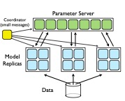
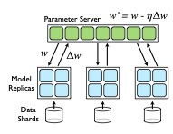
Combine Model and Data Parallelism
Model Parallelism
Data Parallelism
This appears in earlier work on graph systems …
Downpour SGD
Sandblaster L-BFGS

Slide 26
Combine Model and Data Parallelism
Model Parallelism
Data Parallelism
Asynchronous
Synchronous
Downpour SGD
Sandblaster L-BFGS

Slide 27
Sandblaster L-BFGS
Data Parallelism
Model Parallelism
L-BFGS
Commonly used for convex opt. problems
Requires repeated scans of all data
Robust, minimal tuning
Naturally fits map-reduce pattern
Innovations:
accumulate gradients and store outputs in a sharded key value store (parameter server)
Tiny tasks + backup tasks to mitigate stragglers
Synchronous
Asynchronous
Downpour SGD

Slide 28
Combine Model and Data Parallelism
Model Parallelism
Data Parallelism
Asynchronous
Synchronous
Downpour SGD
Sandblaster L-BFGS

Slide 29
Downpour SGD
Data Parallelism
Model Parallelism
Claimed Innovations
Parameter Server
Combine model and data parallelism in an async. execution.
Adagrad stabilization
Warmstarting
Asynchronous
Synchronous
Sandblaster L-BFGS

Slide 30
Parameter Servers
Essentially a sharded key-value store
support for put, get, add
Idea appears in earlier papers:
“An Architecture for Parallel Topic Models”, Smola and Narayanamruthy. (VLDB’10)
“Scalable Inference in Latent Variable Models”, Ahmed, Aly, Gonzalez, Narayanamruthy, and Smola. (WSDM’12)
Asynchronous
DistBelief was probably the first paper to call a sharded key-value store a Parameter Server.

Slide 31
Downpour SGD
Data Parallelism
Model Parallelism
Claimed Innovations
Parameter Server
Combine model and data parallelism in an async. execution.
Adagrad stabilization
Warmstarting
Asynchronous
Synchronous
Sandblaster L-BFGS

Slide 32
Adagrad Stabilization
Address large variability in magnitudes of gradients
Rescale the gradients by an estimate of the diagonal variance
More recently superseded by Adam
Stability is needed here to support asynchronous gradient updates
Notes:
Proposed by Duchi et al. “Adaptive Subgradient Methods for Online Learning and Stochastic Optimization”

Slide 33
Warmstarting
Starting closer to a solution can help!
Recall
initial vector (random, zeros …)
For t from 0 to convergence:
Stochastic Gradient Descent

Slide 34
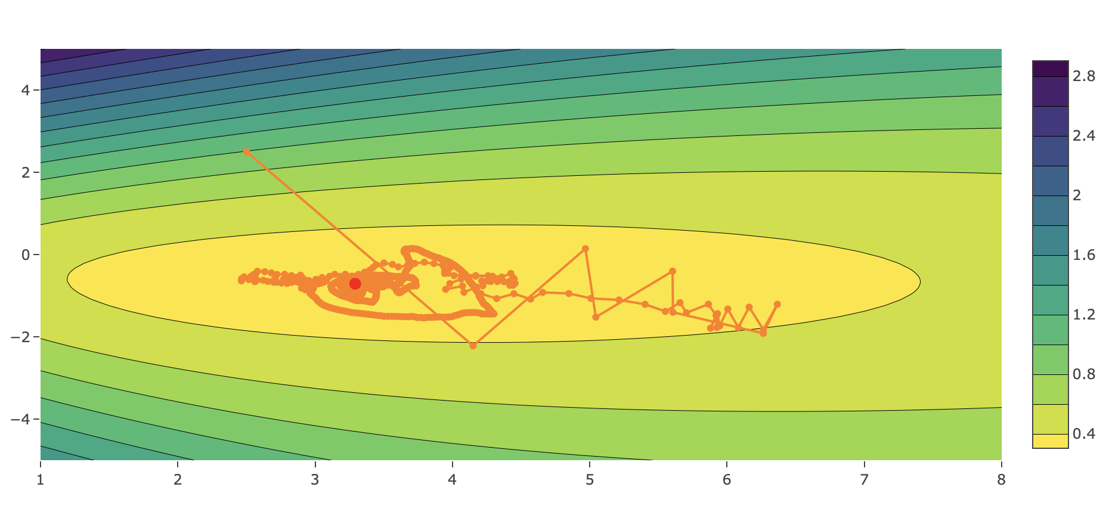
Initial Value
Solution path for stochastic gradient on a 2d logistic regression problem.
Steep Gradient
Closer to the solution gradient is smoother.
See http://www.ds100.org/fa17/assets/notebooks/26-lec/Logistic_Regression_Part_2.html

Slide 35
Key Results
Model Parallelism
Measured speedup to compute a single mini-batch
Is this a good metric?
Results are not that strong…

Slide 36
Key Results: Training and Test Error
Which would you use?
Weird 20K Error Metric
Looks like learning rate reset
Wall clock time is good.

Slide 37
Why are they in the NY Times
Trained a 1.7 billion parameter model (30x larger than state-of-the-art) (was it necessary?)
Using 16,000 cores (efficiently?)
Achieves 15.8 accuracy on ImageNet 20K (70% improvement over state of the art).
Non-standard benchmark
Qualitatively interesting results

Slide 38
Long-term Impact
The parameter server appears in many later machine learning systems
Downpour (Asynchronous) SGD has been largely replaced by synchronous systems for supervised training
Asynchrony is still popular in RL research
Why?
Model parallelism is still used for large language models
Predated this work
The neural network architectures studied here have been largely replaced by convolutional networks

Slide 39
Second Paper
2018 (Unpublished on Arxiv)
NIPS 2012 (Same Year as AlexNet)
Generated a lot of press
Recently (Aug) surpassed by
Fast.ai: “Now anyone can train ImageNet in 18 minutes for $40.” blog post
Popularized linear learning rate scaling

Slide 40
Contrasting to the first paper
Synchronous SGD
Much of the recent work has focused on synchronous setting
Easier to reason about
Focus exclusively on data parallelism: batch-size scaling
Focuses on the generalization gap problem

Slide 41
How do you distribute SGD?
initial vector (random, zeros …)
For t from 0 to convergence:
Stochastic Gradient Descent
Slow? (~150ms) Depending on size of B
Data Parallelism

Slide 42
Batch Size Scaling
Increase the batch size by adding machines
Each server processes a fixed batch size (e.g., n=32)
As more servers are added (k) the effective overall batch size increases linearly
Why do these additional servers help?

Slide 43
Bigger isn’t Always Better
Motivation for larger batch sizes
More opportunities for parallelism → but is it useful?
Recall (1/n variance reduction):
Is a variance reduction helpful?
Only if it let’s you take bigger steps (move faster)
Doesn’t affect the final answer…

Slide 44
Generalization Gap Problem
Larger batch sizes harm generalization performance.

Slide 45
Rough “Intuition”
Small batch gradient descent acts as a regularizer
Loss
Sharp Minima Hypothesis
Parameter values along some direction
Key problem: Addressing the generalization gap for large batch sizes.

Slide 46
Solution: Linear Scaling Rule
Scale the learning rate linearly with the batch size
Addresses generalization performance by taking larger steps (also improves training convergence)
Sub-problem: Large learning rates can be destabilizing in the beginning. Why?
Gradual warmup solution: increase learning rate scaling from constant to linear in first few epochs
Doesn’t help for very large k…

Slide 47
Other Details
Independent Batch Norm: Batch norm calculation applies only to local batch size (n).
All-Reduce: Recursive halving and doubling algorithm
Used instead of popular ring reduction (fewer rounds)
Gloo a library for efficient collective communications
Big Basin GPU Servers: Designed for deep learning workloads
Analysis of communication requirements → latency bound
No discussion on straggler or fault-tolerance
Why?!

Slide 48
Key Results
Training vs Validation
All curves closely match using the linear scaling rule.
Note learning rate schedule drops.

Slide 49
Key Results
“Learning” Epoch
Epoch
Second
Machine Learning
System

Slide 50
Key Results
Train ResNet-50 to state-of-the-art on 256 GPUs in 1 hour
90% scaling efficiency
Fairly careful study of the linear scaling rule
Observed limits to linear scaling do not depend on dataset size
Cannot scale parallelism with dataset size

Slide 51
Long-term Impact
Still early (this paper is not yet published)
Ideas that will appear in other papers
Linear rate scaling
Independent batch norm
Paper points to limits of Synchronous SGD → need new methods to accelerate training
Eg.: Fast.ai → curriculum learning though scale variation

Slide 52
Questions for Discussion
Distributed model training is not very common. Why?
Should we return to asynchrony?
What is needed to address issues with asynchronous training?
How will changes in hardware affect distributed training
E.g., faster GPUs → larger batches, faster networks → smaller batches …
How will the emergence of “dynamic models” and large “mixture of expert models” affect distributed training?

